Slide 1

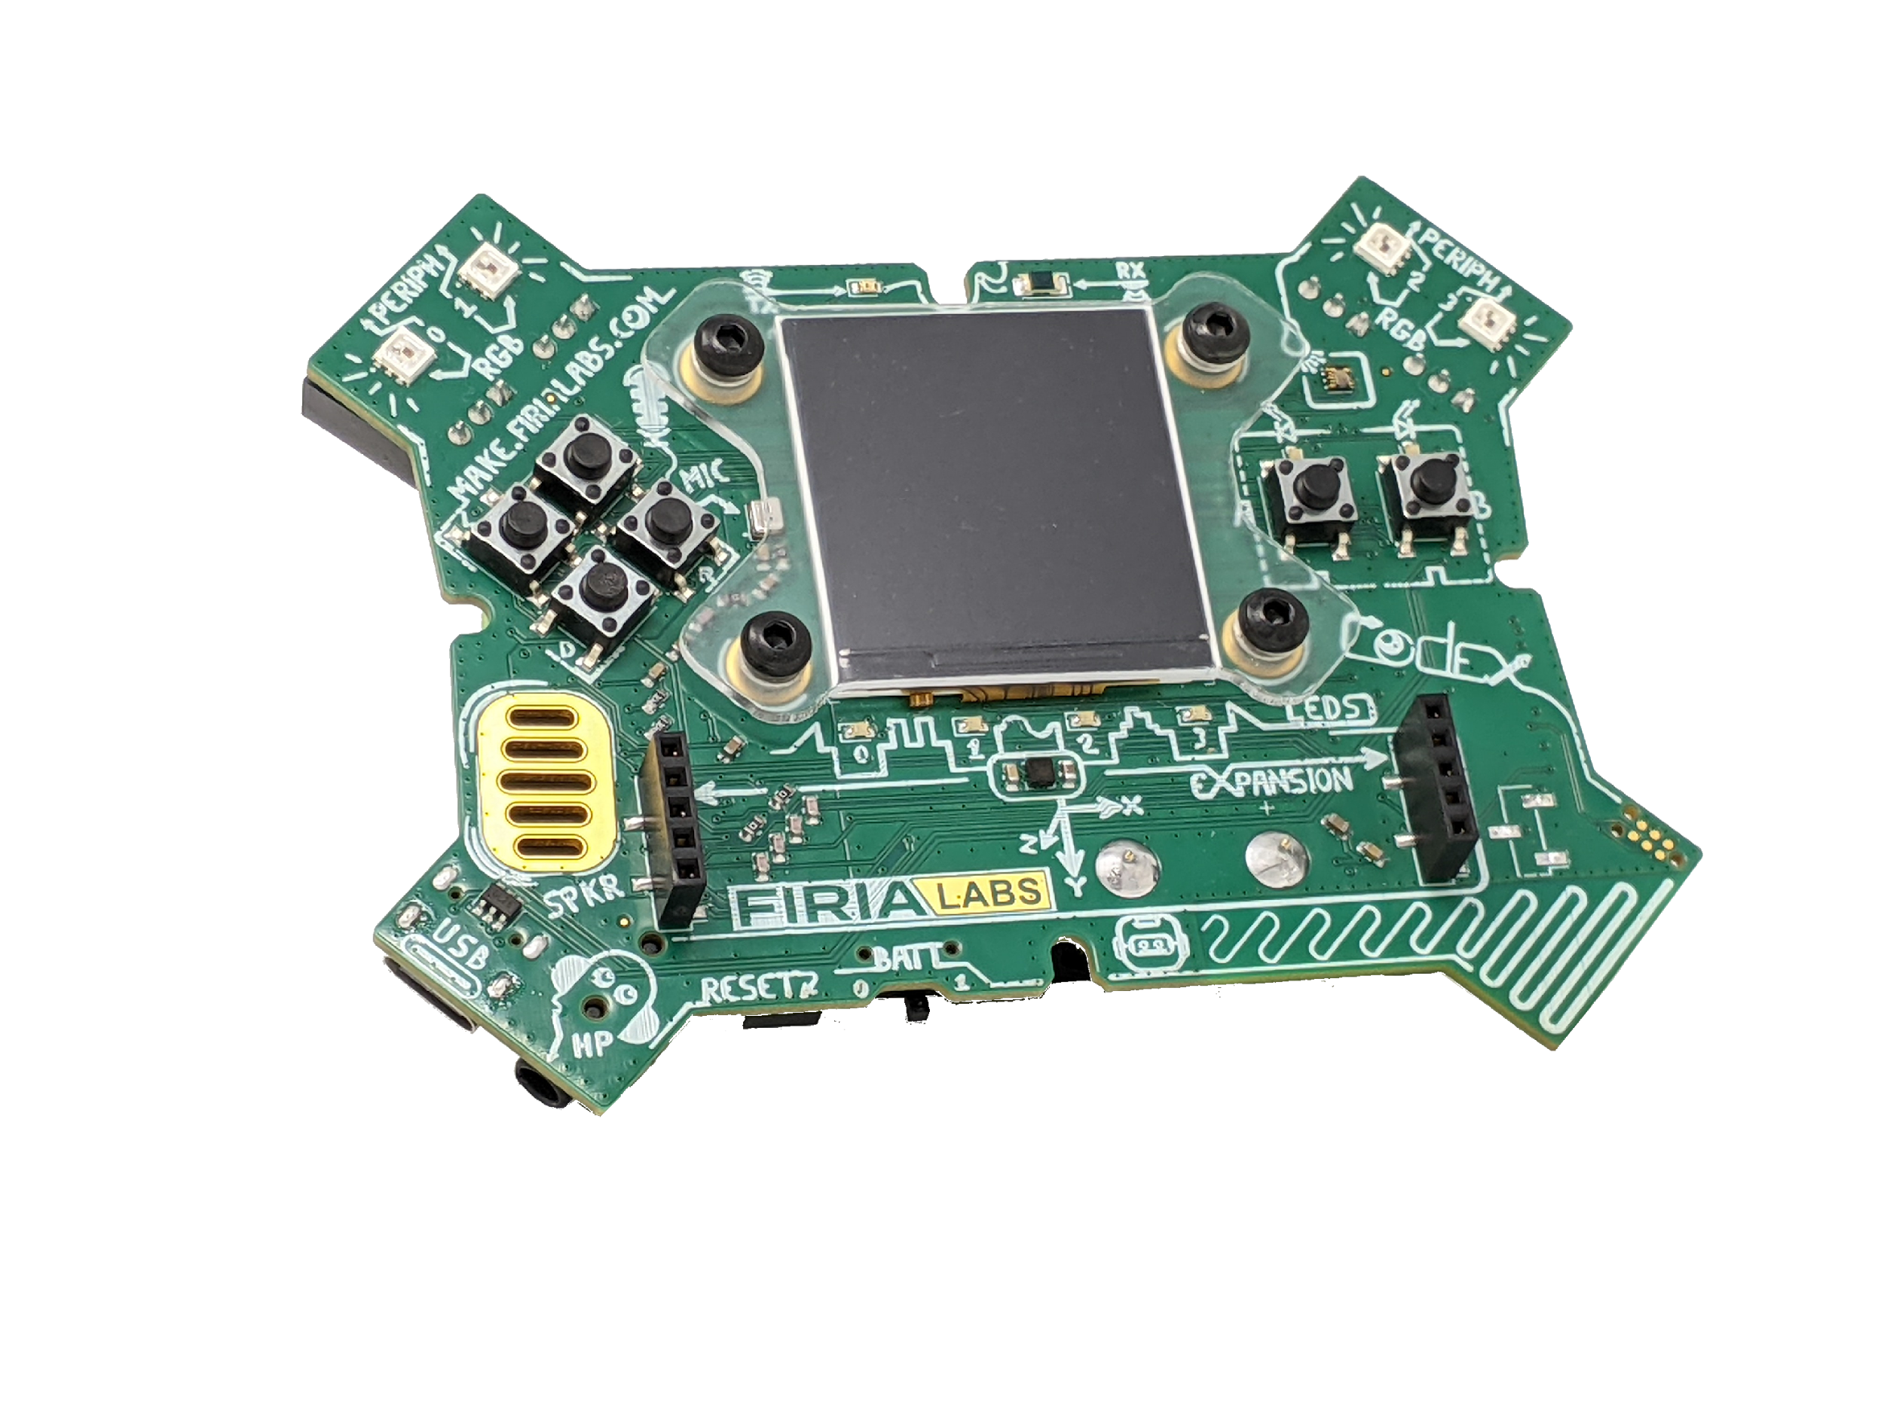
Physical Science meets
Physical Computing!
A Cross-Curricular Mission for Firia Labs CodeX

Slide 2
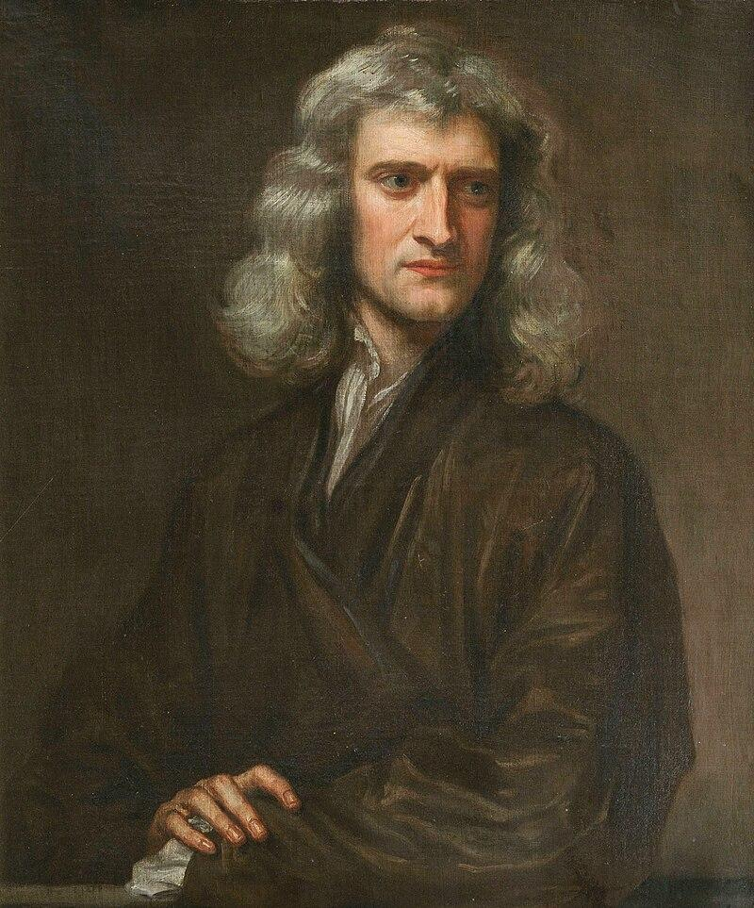
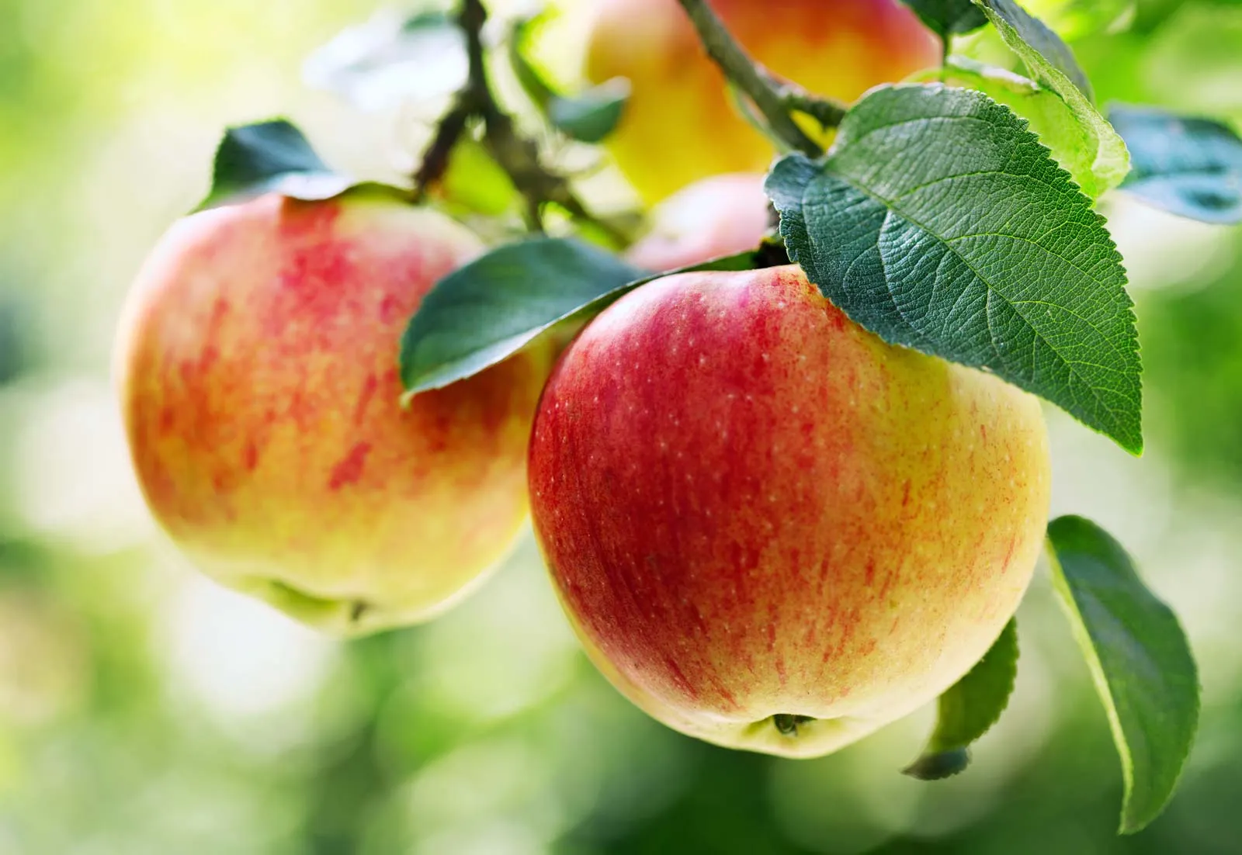
Discovering Motion: Newton’s Laws
Sir Isaac Newton – English lad who wanted to know how things work.
For example, why does an apple always fall toward the earth’s center, and not, say, sideways?
Wasn’t afraid to invent a few tools along the way. Calculus, for example.
Formulated three “Laws of Motion”
  We will focus on the 2nd Law…
1643 - 1727

Slide 3
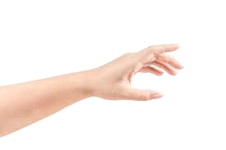
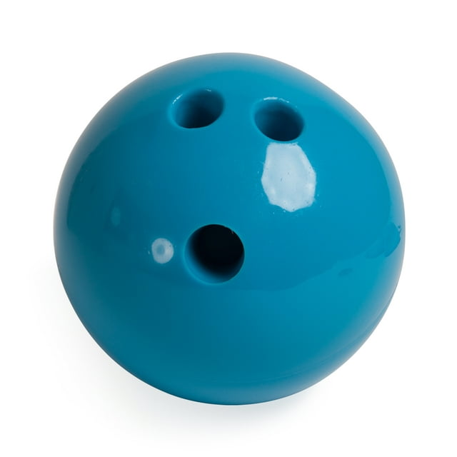
Newton’s Second Law of Motion
The force on a body is equal to its mass times its acceleration: f = ma
  Force: A push or a pull on an object (measured in Newtons, N).
  Mass: How much matter is in an object (measured in kilograms, kg).
  Acceleration: How quickly the object's velocity is changing (measured in meters per second squared, m/s²)
f
a
m

Slide 4
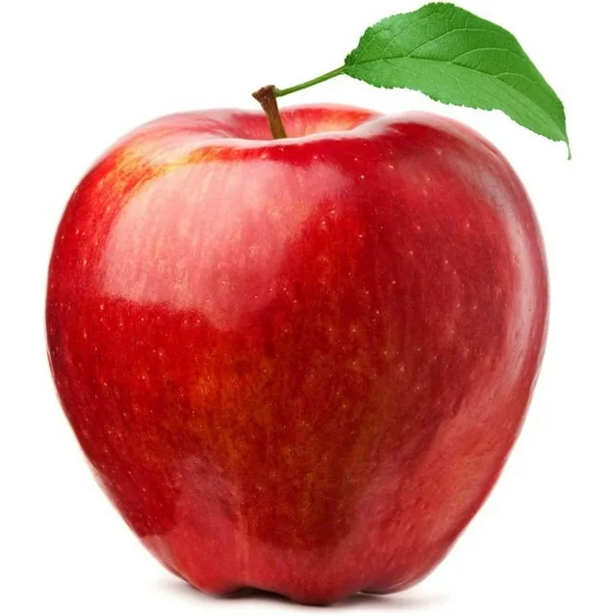
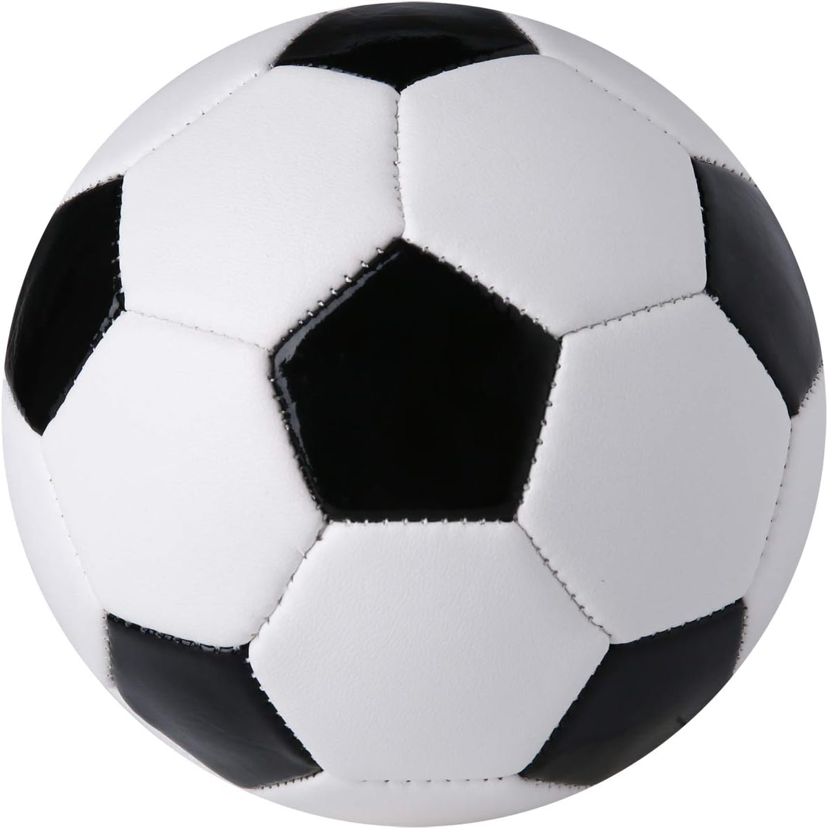
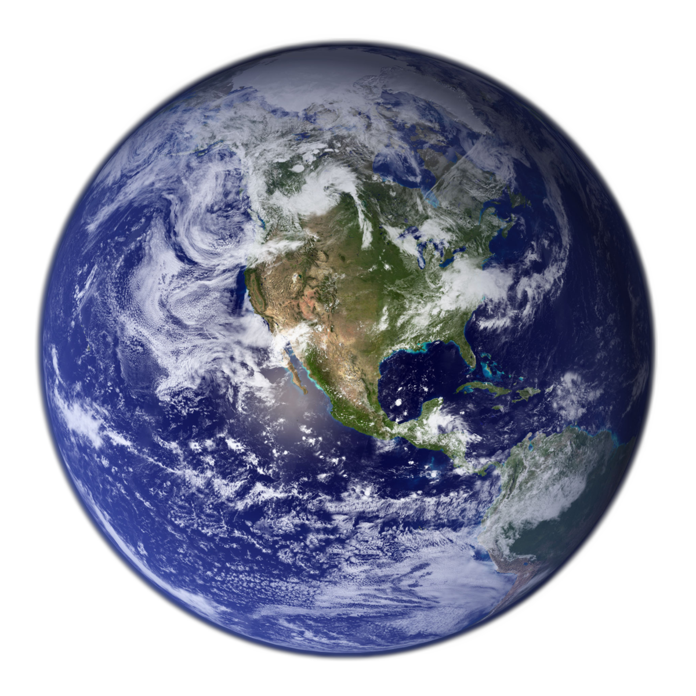
Newton’s Second Law in Real Life
Applying the same force to different mass objects results in different accelerations.
a1
a2
f = ma
Gravity creates a constant acceleration of 9.8 m/s²
  That means every object falls at the same speed!
  …except for the small matter of air resistance.
Relating acceleration and distance: a = 2d / t²

Slide 5
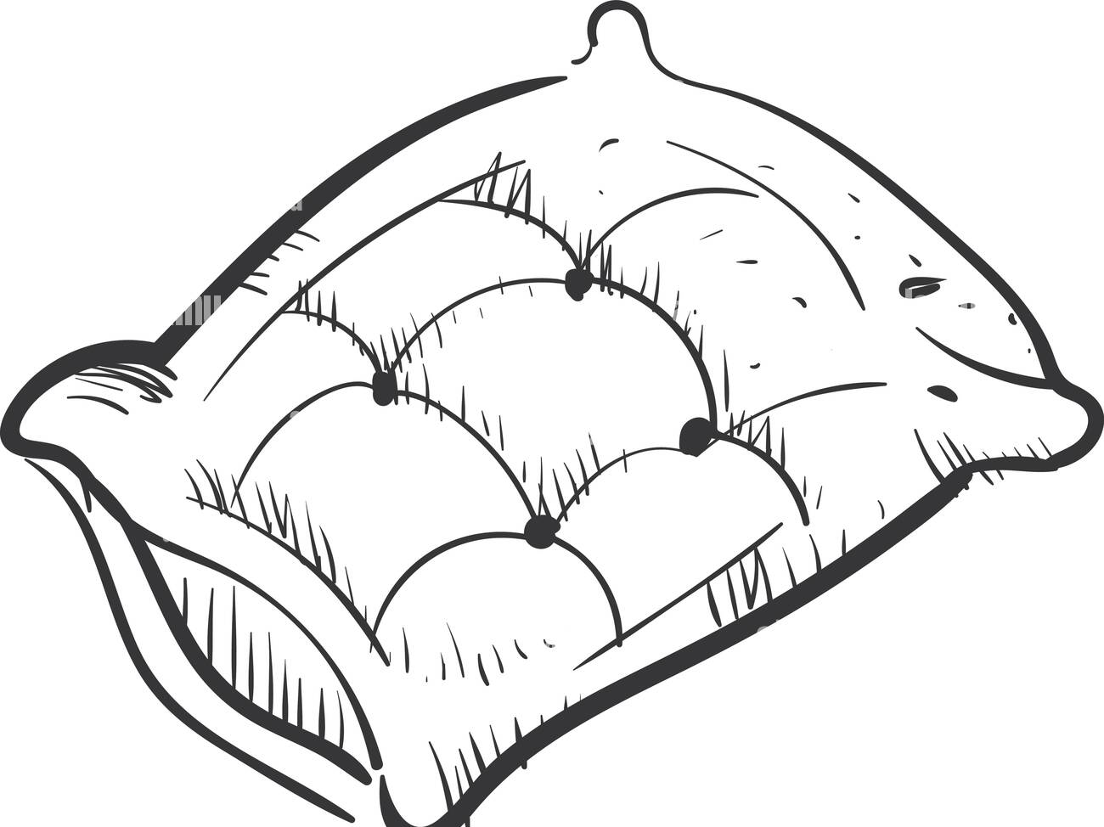
Fact Checking Newton
Can you measure gravitational acceleration?
  This is your challenge!
First, detect when your CodeX is in FREE FALL ☺
from codex import *
from soundlib import *
from time import ticks_ms, ticks_diff
THRESH = 3000
tone = soundmaker.get_tone('trumpet')
def is_falling():
x,y,z = accel.read()
return abs(x) < THRESH and abs(y) < THRESH and abs(z) < THRESH
while True:
if is_falling():
tone.play()
else:
tone.stop()

Slide 6
Time for Measurement, Scientists!
Change your loop to measure how long the CodeX is falling.
while True:
display.print("GRAVITY TEST", scale=3, color=BLUE)
display.print("Press A to ARM...")
leds.set(LED_A, True)
while not buttons.is_pressed(BTN_A):
pass
leds.set(LED_A, False)
fall_detected = False
while not is_falling():
pass
t_start = ticks_ms()
tone.play()
while is_falling():
pass
t_end = ticks_ms()
tone.stop()
t_elapsed = ticks_diff(t_end, t_start)
display.print("Elapsed = %d ms\n" % t_elapsed)
display.print("Press B to continue...")
leds.set(LED_B, True)
inp = buttons._io_expander.get_inputs()
while not buttons.is_pressed(BTN_B):
pass
leds.set(LED_B, False)
display.clear()

Slide 7

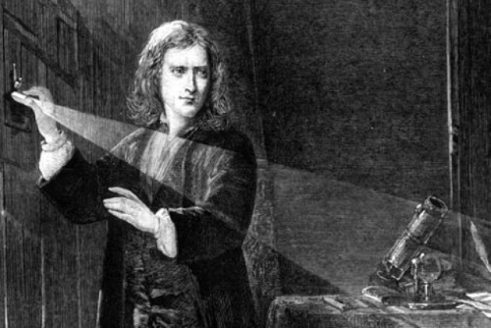
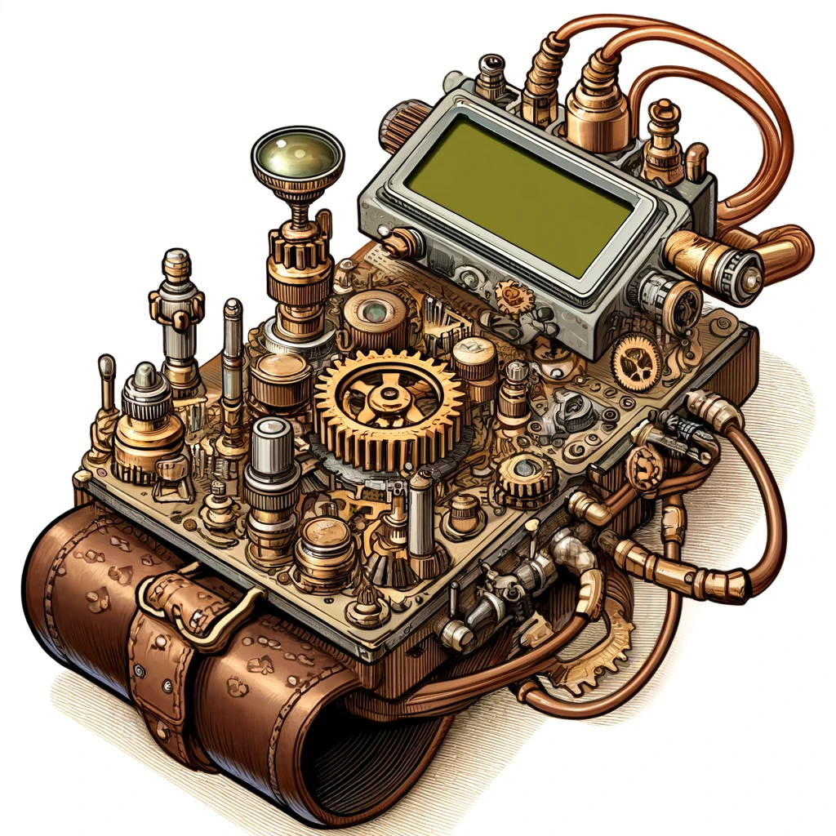
Log Your Measurements… Calculate!
What will your data log look like?
How many experiments will you run?
What parameters will you vary?
Update the Code:
Can you make a vertical distance measurement tool?
Can you make a gravitational acceleration detector?
Aw yeah…

Slide 8
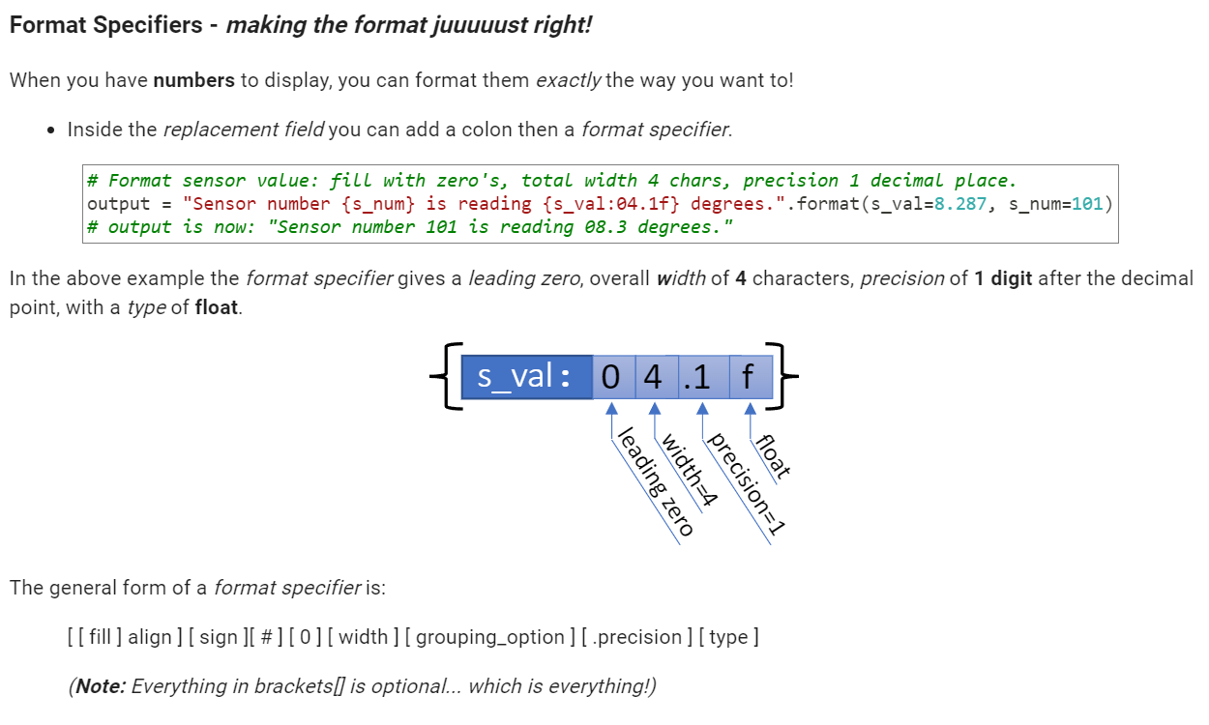
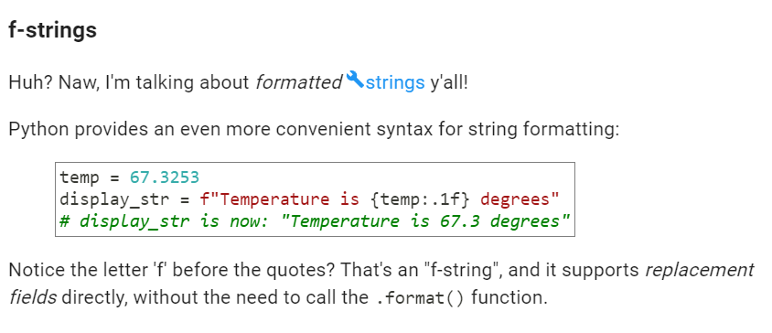
Python String Formatting

